Slide 1

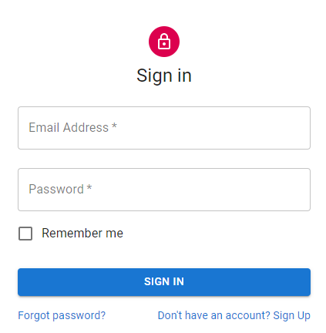

Notes:
https://github.com/mui-org/material-ui/tree/master/docs/src/pages/getting-started/templates/sign-in https://material-ui.com/getting-started/templates/
https://serverless-stack.com/chapters/create-a-login-page.html

Slide 2



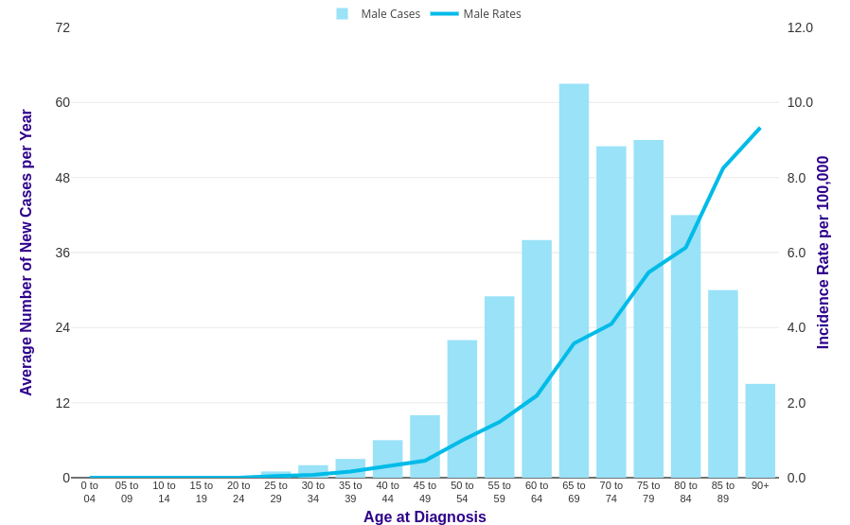
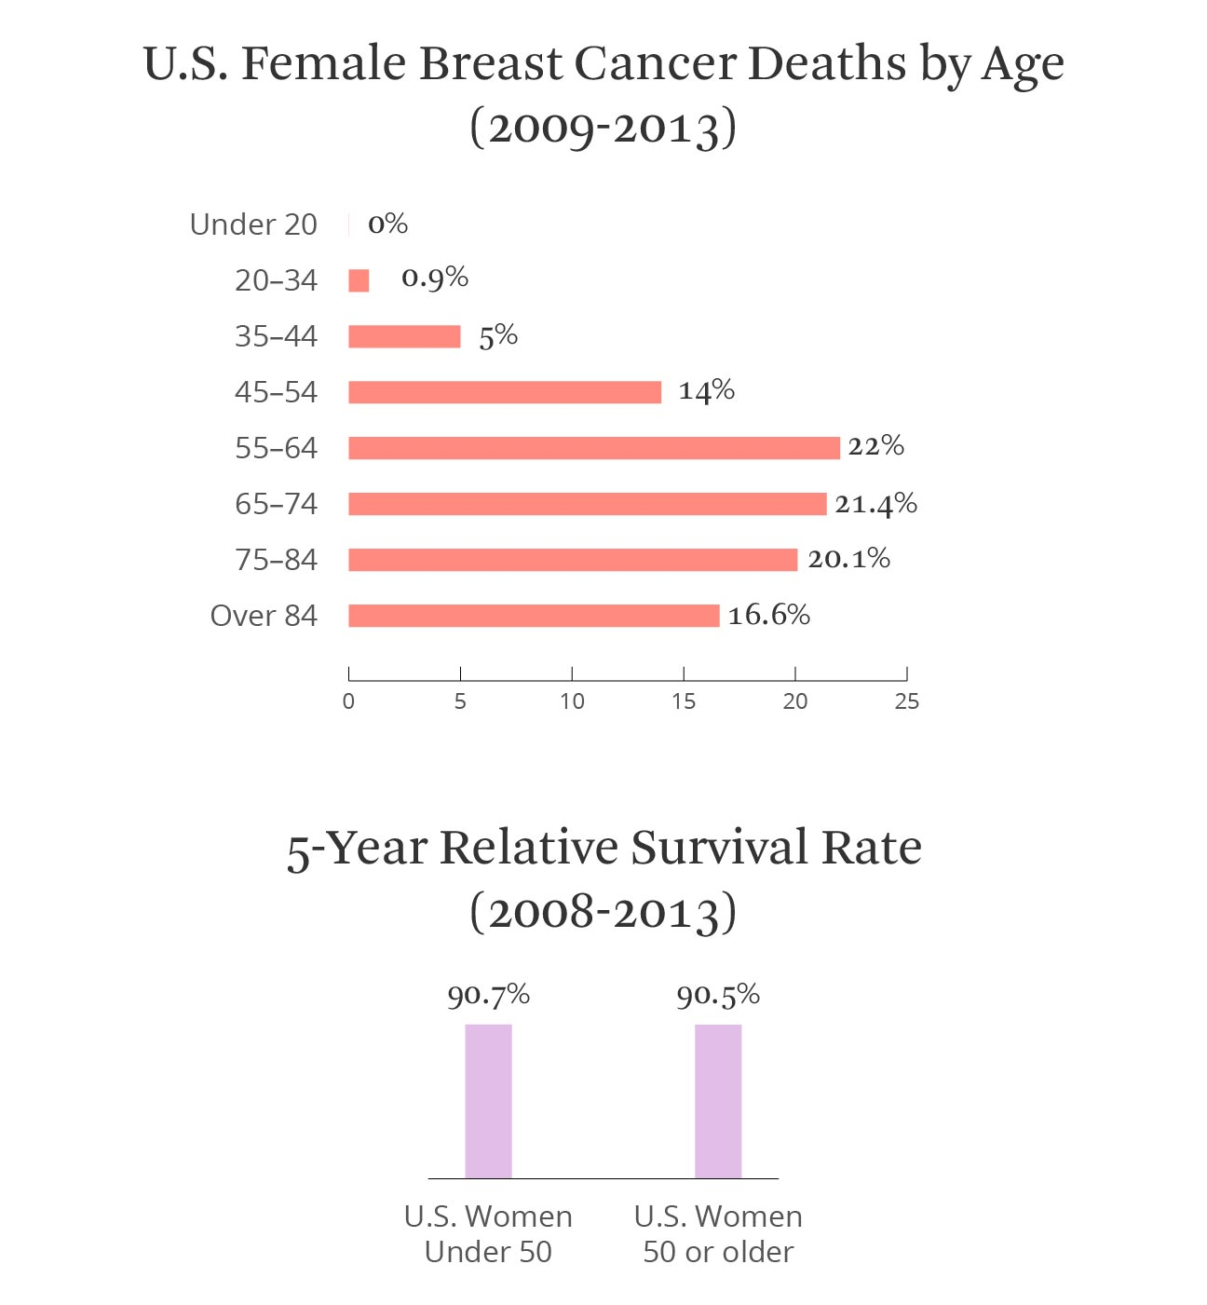
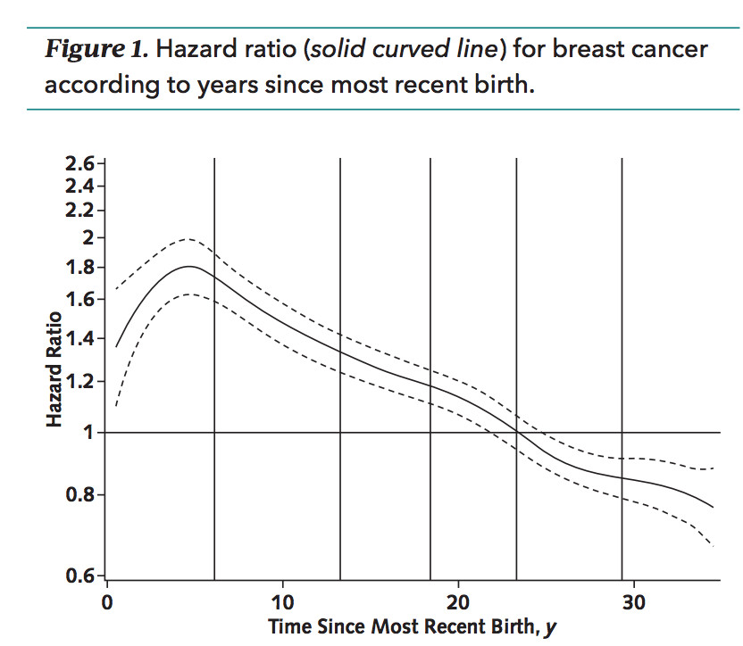
CARE
New Patient
Calculator
Logout
SUMMARY DASHBOARD

Slide 3
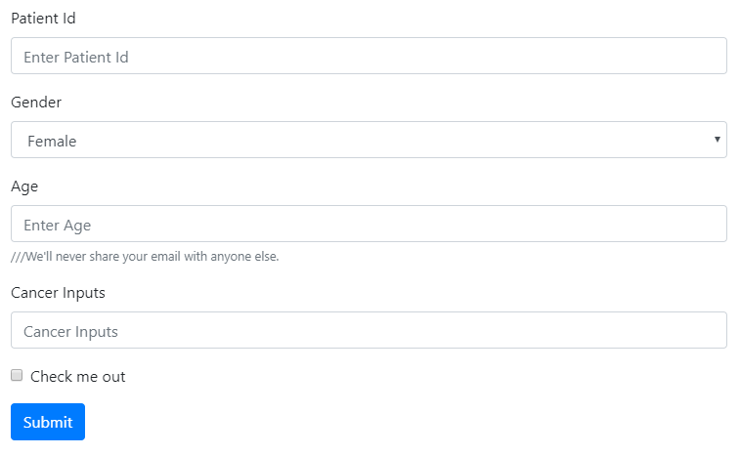


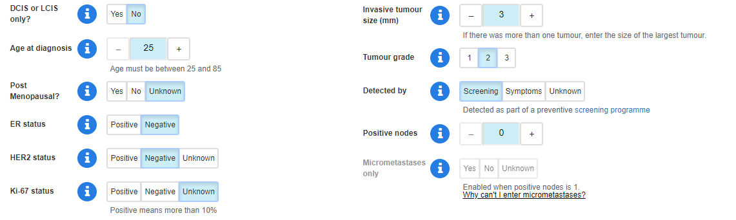
CARE
New Patient
Calculator
Logout
NEW PATIENT DATA
DOB
Notes:
https://react-bootstrap.github.io/components/forms/
<Form>
<Form.Group controlId="formBasicPassword">
<Form.Label>Patient Id</Form.Label>
<Form.Control type="Id" placeholder="Enter Patient Id" />
</Form.Group>
<Form.Group controlId="formBasicEmail">
<Form.Label>Gender</Form.Label>
<Form.Control as="select">
<option>Female</option>
<option>Male</option>
</Form.Control>
<Form.Text className="text-muted">
</Form.Text>
</Form.Group>
<Form.Group controlId="formBasicEmail">
<Form.Label>Age</Form.Label>
<Form.Control type="email" placeholder="Enter Age" />
<Form.Text className="text-muted">
///We'll never share your email with anyone else.
</Form.Text>
</Form.Group>
<Form.Group controlId="formBasicPassword">
<Form.Label>Cancer Inputs</Form.Label>
<Form.Control type="Cancer inputs" placeholder="Cancer Inputs" />
<Form.Text className="text-muted">
</Form.Group>
<Form.Group controlId="formBasicCheckbox">
<Form.Check type="checkbox" label="Check me out" />
</Form.Group>
<Button variant="primary" type="submit">
Submit
</Button>
</Form>

Slide 4
CARE
New Patient
Calculator
Logout
CALCULATOR
Existing Patient Manual Input
Notes:
https://react-bootstrap.github.io/components/forms/
<Form>
<Form.Group controlId="formBasicPassword">
<Form.Label>Patient Id</Form.Label>
<Form.Control type="Id" placeholder="Enter Patient Id" />
</Form.Group>
<Form.Group controlId="formBasicEmail">
<Form.Label>Gender</Form.Label>
<Form.Control as="select">
<option>Female</option>
<option>Male</option>
</Form.Control>
<Form.Text className="text-muted">
</Form.Text>
</Form.Group>
<Form.Group controlId="formBasicEmail">
<Form.Label>Age</Form.Label>
<Form.Control type="email" placeholder="Enter Age" />
<Form.Text className="text-muted">
///We'll never share your email with anyone else.
</Form.Text>
</Form.Group>
<Form.Group controlId="formBasicPassword">
<Form.Label>Cancer Inputs</Form.Label>
<Form.Control type="Cancer inputs" placeholder="Cancer Inputs" />
<Form.Text className="text-muted">
</Form.Group>
<Form.Group controlId="formBasicCheckbox">
<Form.Check type="checkbox" label="Check me out" />
</Form.Group>
<Button variant="primary" type="submit">
Submit
</Button>
</Form>

Slide 5

CARE
New Patient
Calculator
Logout
CALCULATOR
Existing Patient Manual Input
Name: Janet Lin
Gender: F
Age: 55
Diagnosed Age: 54
Cancer stage: 3A
Breast Cancer: Left breast
Tumor Size: 1.2
T-stage: T1c
N-stage: N2
M-stage: M0
CerbB2: positive
HER2: positive
Notes:
https://react-bootstrap.github.io/components/forms/
<Form>
<Form.Group controlId="formBasicPassword">
<Form.Label>Patient Id</Form.Label>
<Form.Control type="Id" placeholder="Enter Patient Id" />
</Form.Group>
<Form.Group controlId="formBasicEmail">
<Form.Label>Gender</Form.Label>
<Form.Control as="select">
<option>Female</option>
<option>Male</option>
</Form.Control>
<Form.Text className="text-muted">
</Form.Text>
</Form.Group>
<Form.Group controlId="formBasicEmail">
<Form.Label>Age</Form.Label>
<Form.Control type="email" placeholder="Enter Age" />
<Form.Text className="text-muted">
///We'll never share your email with anyone else.
</Form.Text>
</Form.Group>
<Form.Group controlId="formBasicPassword">
<Form.Label>Cancer Inputs</Form.Label>
<Form.Control type="Cancer inputs" placeholder="Cancer Inputs" />
<Form.Text className="text-muted">
</Form.Group>
<Form.Group controlId="formBasicCheckbox">
<Form.Check type="checkbox" label="Check me out" />
</Form.Group>
<Button variant="primary" type="submit">
Submit
</Button>
</Form>

Slide 6
CARE
New Patient
Calculator
Logout
CALCULATOR
Existing Patient Manual Input
Inputs are subjected to changes depending on the model inputs
Notes:
https://react-bootstrap.github.io/components/forms/
<Form>
<Form.Group controlId="formBasicPassword">
<Form.Label>Patient Id</Form.Label>
<Form.Control type="Id" placeholder="Enter Patient Id" />
</Form.Group>
<Form.Group controlId="formBasicEmail">
<Form.Label>Gender</Form.Label>
<Form.Control as="select">
<option>Female</option>
<option>Male</option>
</Form.Control>
<Form.Text className="text-muted">
</Form.Text>
</Form.Group>
<Form.Group controlId="formBasicEmail">
<Form.Label>Age</Form.Label>
<Form.Control type="email" placeholder="Enter Age" />
<Form.Text className="text-muted">
///We'll never share your email with anyone else.
</Form.Text>
</Form.Group>
<Form.Group controlId="formBasicPassword">
<Form.Label>Cancer Inputs</Form.Label>
<Form.Control type="Cancer inputs" placeholder="Cancer Inputs" />
<Form.Text className="text-muted">
</Form.Group>
<Form.Group controlId="formBasicCheckbox">
<Form.Check type="checkbox" label="Check me out" />
</Form.Group>
<Button variant="primary" type="submit">
Submit
</Button>
</Form>

Slide 7
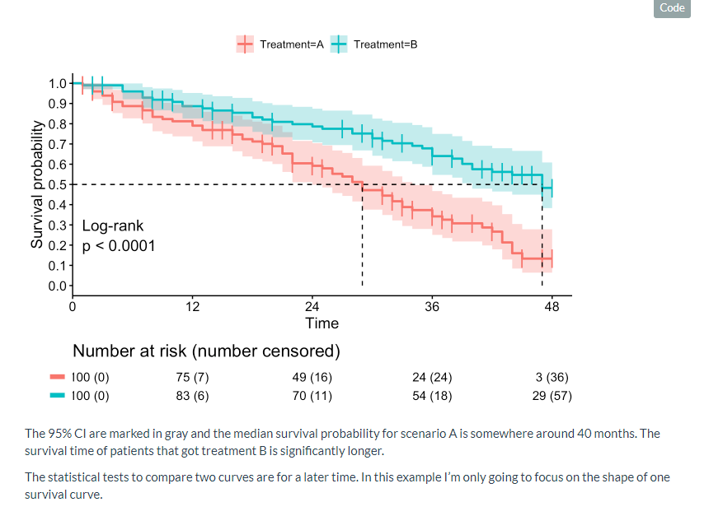
CARE
New Patient
Calculator
Logout
SURVIVAL AND COST PREDICTION CALCULATOR PAGE
SURVIVAL PREDICTION COST PREDICTION
Doctor’s Summary Patient’s Summary
Overall Survival for T1N1M1 up to 10 years
Disease-Free Survival for T1N1M1 up to 10 years
Notes:
https://react-bootstrap.github.io/components/forms/
<Form>
<Form.Group controlId="formBasicPassword">
<Form.Label>Patient Id</Form.Label>
<Form.Control type="Id" placeholder="Enter Patient Id" />
</Form.Group>
<Form.Group controlId="formBasicEmail">
<Form.Label>Gender</Form.Label>
<Form.Control as="select">
<option>Female</option>
<option>Male</option>
</Form.Control>
<Form.Text className="text-muted">
</Form.Text>
</Form.Group>
<Form.Group controlId="formBasicEmail">
<Form.Label>Age</Form.Label>
<Form.Control type="email" placeholder="Enter Age" />
<Form.Text className="text-muted">
///We'll never share your email with anyone else.
</Form.Text>
</Form.Group>
<Form.Group controlId="formBasicPassword">
<Form.Label>Cancer Inputs</Form.Label>
<Form.Control type="Cancer inputs" placeholder="Cancer Inputs" />
<Form.Text className="text-muted">
</Form.Group>
<Form.Group controlId="formBasicCheckbox">
<Form.Check type="checkbox" label="Check me out" />
</Form.Group>
<Button variant="primary" type="submit">
Submit
</Button>
</Form>

Slide 8
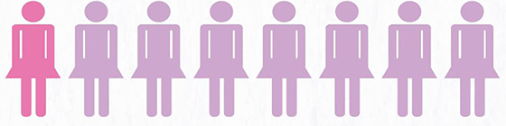
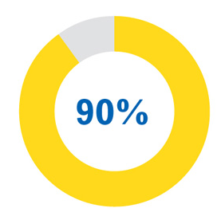
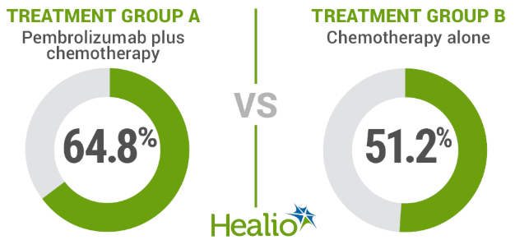
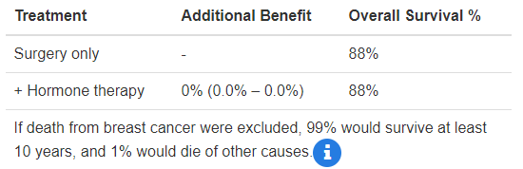
CARE
New Patient
Calculator
Logout
SURVIVAL AND COST PREDICTION CALCULATOR PAGE
SURVIVAL PREDICTION COST PREDICTION
Doctor’s Summary Patient’s Summary
FOR T0N0M0, OUT OF 100 PEOPLE, 80 PEOPLE SURVIVED
FOR T0N0M0 2,5,10 YEAR SURVIVAL RATE
FOR T0N0M0 OVERALL SURVIVAL RATE (With different treatment)
FOR T0N0M0 with triple negative breast cancer
Notes:
https://react-bootstrap.github.io/components/forms/
<Form>
<Form.Group controlId="formBasicPassword">
<Form.Label>Patient Id</Form.Label>
<Form.Control type="Id" placeholder="Enter Patient Id" />
</Form.Group>
<Form.Group controlId="formBasicEmail">
<Form.Label>Gender</Form.Label>
<Form.Control as="select">
<option>Female</option>
<option>Male</option>
</Form.Control>
<Form.Text className="text-muted">
</Form.Text>
</Form.Group>
<Form.Group controlId="formBasicEmail">
<Form.Label>Age</Form.Label>
<Form.Control type="email" placeholder="Enter Age" />
<Form.Text className="text-muted">
///We'll never share your email with anyone else.
</Form.Text>
</Form.Group>
<Form.Group controlId="formBasicPassword">
<Form.Label>Cancer Inputs</Form.Label>
<Form.Control type="Cancer inputs" placeholder="Cancer Inputs" />
<Form.Text className="text-muted">
</Form.Group>
<Form.Group controlId="formBasicCheckbox">
<Form.Check type="checkbox" label="Check me out" />
</Form.Group>
<Button variant="primary" type="submit">
Submit
</Button>
</Form>

Slide 9
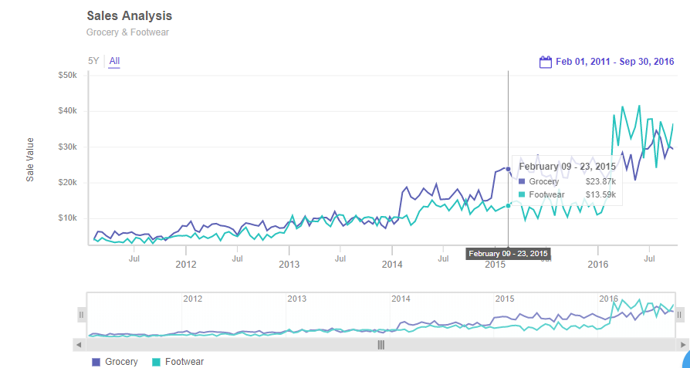
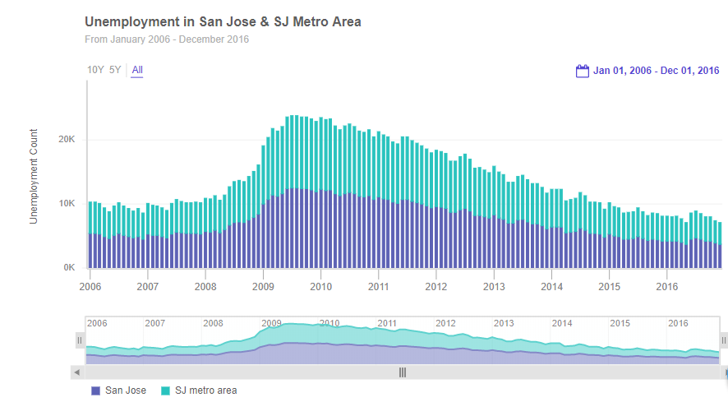
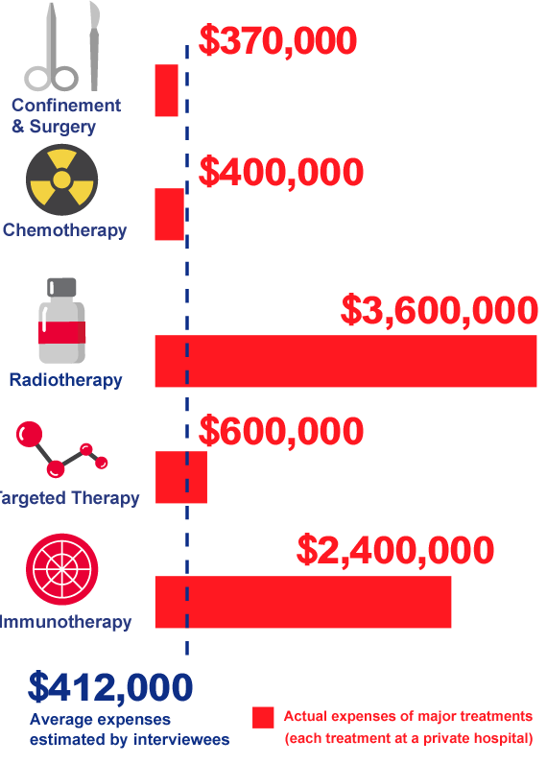
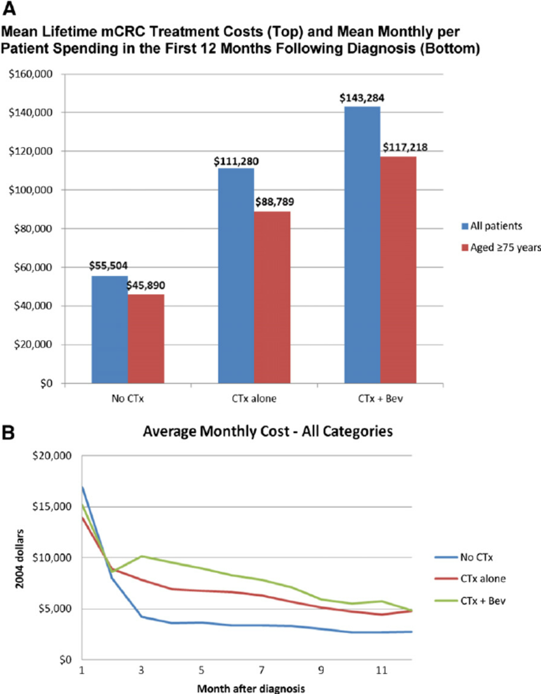
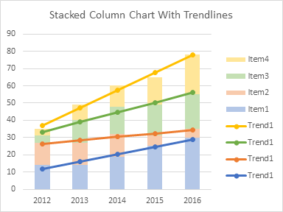
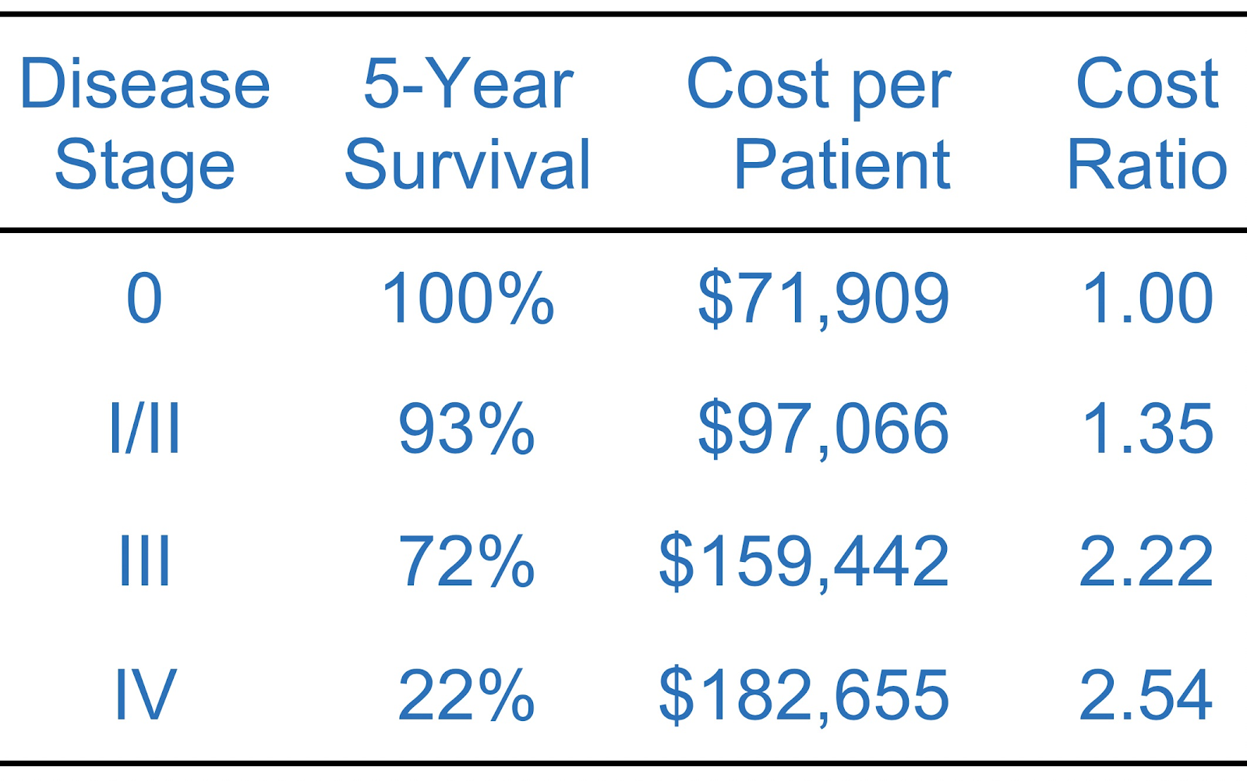
CARE
New Patient
Calculator
Logout
SURVIVAL AND COST PREDICTION CALCULATOR PAGE
SURVIVAL PREDICTION COST PREDICTION
Notes:
https://react-bootstrap.github.io/components/forms/
<Form>
<Form.Group controlId="formBasicPassword">
<Form.Label>Patient Id</Form.Label>
<Form.Control type="Id" placeholder="Enter Patient Id" />
</Form.Group>
<Form.Group controlId="formBasicEmail">
<Form.Label>Gender</Form.Label>
<Form.Control as="select">
<option>Female</option>
<option>Male</option>
</Form.Control>
<Form.Text className="text-muted">
</Form.Text>
</Form.Group>
<Form.Group controlId="formBasicEmail">
<Form.Label>Age</Form.Label>
<Form.Control type="email" placeholder="Enter Age" />
<Form.Text className="text-muted">
///We'll never share your email with anyone else.
</Form.Text>
</Form.Group>
<Form.Group controlId="formBasicPassword">
<Form.Label>Cancer Inputs</Form.Label>
<Form.Control type="Cancer inputs" placeholder="Cancer Inputs" />
<Form.Text className="text-muted">
</Form.Group>
<Form.Group controlId="formBasicCheckbox">
<Form.Check type="checkbox" label="Check me out" />
</Form.Group>
<Button variant="primary" type="submit">
Submit
</Button>
</Form>

Slide 10

CARE
New Patient
Calculator
Logout
YOUR LOGOUT HAS BEEN SUCCESSFUL !
Login Again
Notes:
https://react-bootstrap.github.io/components/forms/
<Form>
<Form.Group controlId="formBasicPassword">
<Form.Label>Patient Id</Form.Label>
<Form.Control type="Id" placeholder="Enter Patient Id" />
</Form.Group>
<Form.Group controlId="formBasicEmail">
<Form.Label>Gender</Form.Label>
<Form.Control as="select">
<option>Female</option>
<option>Male</option>
</Form.Control>
<Form.Text className="text-muted">
</Form.Text>
</Form.Group>
<Form.Group controlId="formBasicEmail">
<Form.Label>Age</Form.Label>
<Form.Control type="email" placeholder="Enter Age" />
<Form.Text className="text-muted">
///We'll never share your email with anyone else.
</Form.Text>
</Form.Group>
<Form.Group controlId="formBasicPassword">
<Form.Label>Cancer Inputs</Form.Label>
<Form.Control type="Cancer inputs" placeholder="Cancer Inputs" />
<Form.Text className="text-muted">
</Form.Group>
<Form.Group controlId="formBasicCheckbox">
<Form.Check type="checkbox" label="Check me out" />
</Form.Group>
<Button variant="primary" type="submit">
Submit
</Button>
</Form>

